Slide 1

GIZ Open Regional Fund – Energy Efficiency
Monitoring and Verification Platform
MVP
Berina Delalić
Banja Luka, 25.09.2014.
Notes:
1

Slide 2
Contents
Aim and purpose of MVP: How it all began?
Concept behind the MVP: Simplicity and flexibility
BU methodology: Calculation of energy savings
Structure of MVP: View of application front page
Users: Who is responsible and who can benefit?
Data feed-in: One time entry
Required resources: Installation and maintenance
Data output: Excel form reports
Connecting with other systems: Potential
Limitations of the MVP
Demonstration of MVP – testing environment

Slide 3
Monitoring and verification of energy savings
Reporting on NEEAP implementation
Top Down methodology
  Poor energy statistic
  Estimation error > planned savings
Bottom up methodology
  Real-life EE project
  Actual values
SEAPs and other local energy efficiency action plans
Target: CO2 emission reduction
Calculated from energy savings
Similarity in planned EE measure (Public sector!)
Better consistency between local and national level required
Application – web tool
Data base: all the EE projects in one place
Cost effective solution: one application for all EE plans and measures in country
BU approach: energy savings calculated and estimated in straightforward manner
Information and communication platform

Slide 4
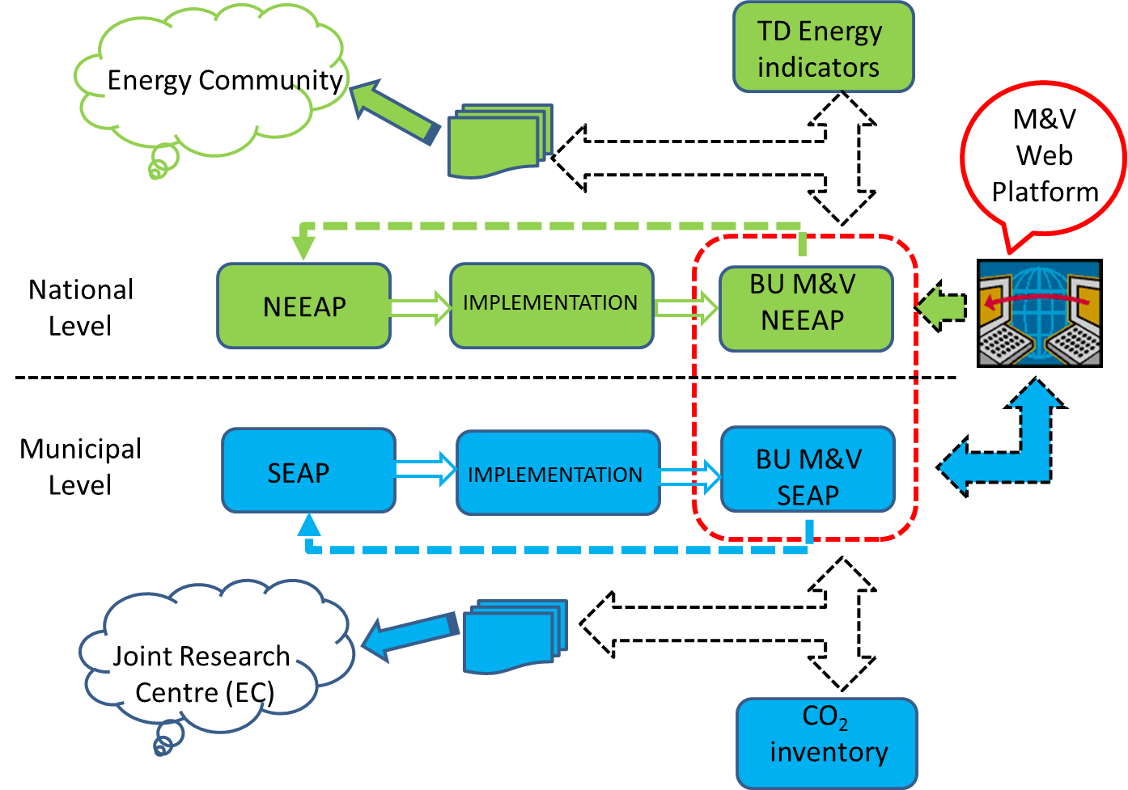
M&V platform purpose(s)
Activities of GIZ ORF-EE are three years part of the work Program of EECG group (Energy Community)

Slide 5

Concept of MVP
Based on BU methodology (EnC)
Simple and flexible!
Unique data structure for SEE countries
Different administrative structure of different SEE countries!
Arbitrary number of EE policy plans (SEAP, County plan, …, NEEAP)!
Actual values for characteristic parameters – preferable
Referent values – BU methodology for every country

Slide 6



How do we calculate energy savings?
Simple, algebraic equations related to energy consumption before and after implementation of EE measure
$$E_{savings} =E_{old}−E_{new} [kWh];$$
${CO}_{2 reduct}=E_{old}∗f_{{CO}_{2 old}}−E_{new}∗f_{{CO}_{2 new}} [t];$
$E_{savings}$– annual energy savings [kWh/a]
$E_{old/new}$ – energy consumption before/after EE measure, respectively [kWh/a]
${CO}_{2 reduct}$ – CO2 emission reduction [tCO2]
$f_{{CO}_{2 old/new}}$– CO2 emission factors old/new [tCO2/kWh]

Slide 7

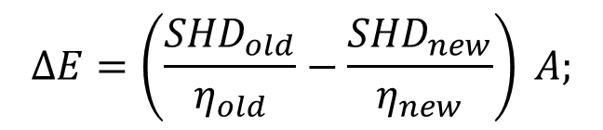

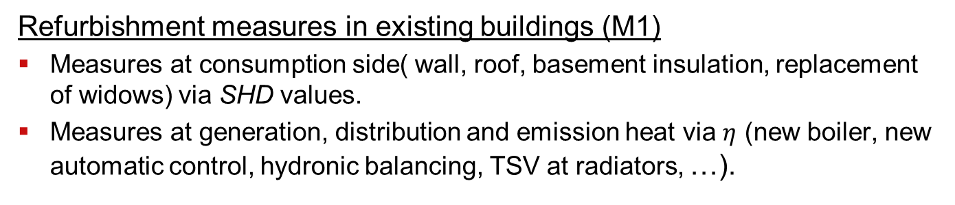




How do we calculate energy savings (example)?
Refurbishment measures in existing buildings (M1)
Measures at consumption side( wall, roof, basement insulation, replacement of widows) via SHD values.
Measures at generation, distribution and emission heat via $η$ (new boiler, new automatic control, hydronic balancing, TSV at radiators, …).
$$∆E=\left(\frac{{SHD}_{old}}{η_{old}}−\frac{{SHD}_{new}}{η_{new}}\right) A;$$
${SHD}_{new}$ < ${SHD}_{old}$
AND/OR
$η_{new}$ > $η_{old}$
$∆E$ – annual energy savings [kWh/a]
$SHD$ – specific heat demand [kWh/m²a]
Reference SHD values - CRO
$A$ – heated area [m²]
Construction year | SHD residential | SHD non-residential
before 1940 | 180 | 180
1940 – 1970 | 250 | 250
1970 – 1987 | 150 | 150
1987 – 2006 | 150 | 150
$η=η_{boi}∙η_{dis}∙η_{emis}$ [%]
Seasonal efficiency of heating system (before/after)

Slide 8
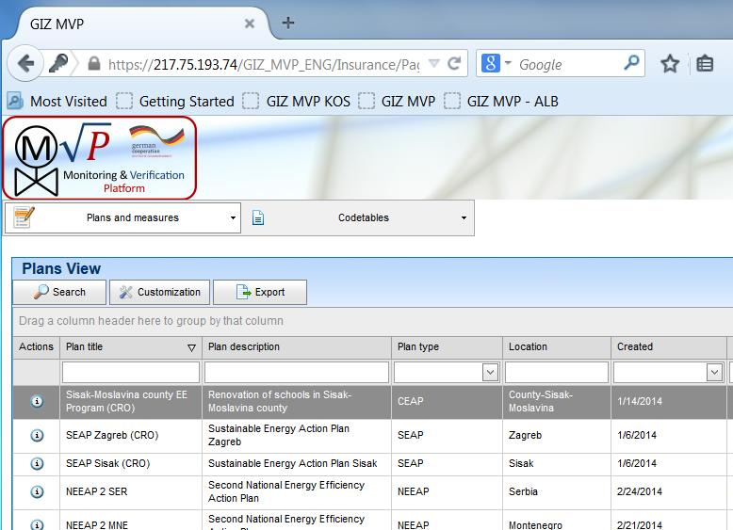
MVP – web application structure
1 Main menus
2 Command buttons
3 Grouping area
4 Action buttons
5 Field headings
6 Sorting fields
1
2
3
5
Plans
Planned measures
Implemented measures
Location
Codetables
6
4
MVP screen shot – front page

Slide 9



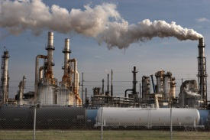
MVP in use (data entry, users and requirements)
EE plans at different policy levels
Assignment process
Counties/
Districts
Cities
State
Server
Implemented projects
Registration of
Implemented
measure

Slide 10
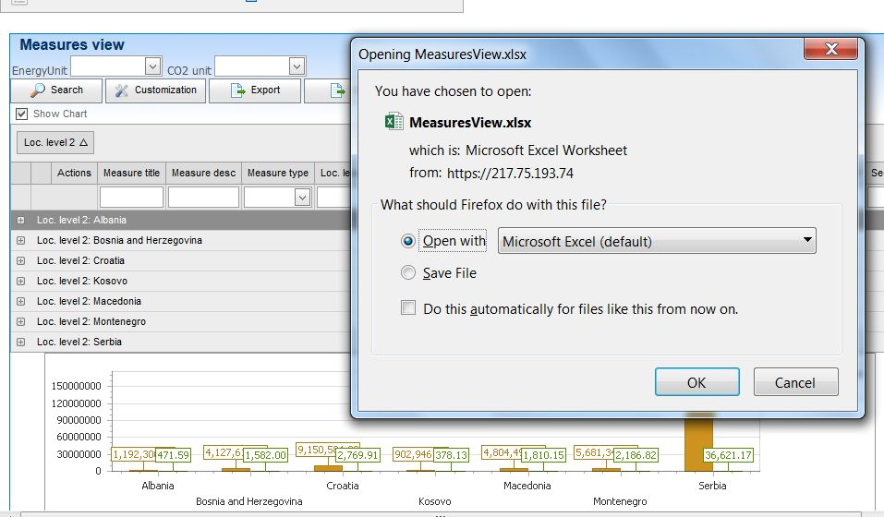
Export and managing of data
What you see is what you get
Flexible report form
Further arrangements and data managing

Slide 11
Interaction of MVP with other software
Inputs to MVP
EA, BC database:
Calculated values:
  SHD, SWD
  Boiler, distribution and emission efficiencies
EMS database:
Measured values:
  SHD, SWD
  Heating/Cooling system efficiency!
  Energy savings due to EM procedures!
EA,BC
MVP
Buildings‘ ID
EMS
Cadastral
number
Legend:
EA,BC – Energy Audits and
Building Certification DB.
EMS – Energy management system DB.
MVP – Monitoring and Verification Platform.

Slide 12
MVP Web Platform – to sum up!
Data on energy savings, CO₂ emision reduction and costs at one place!
Unique and innovative platform!
Graphical user interface .NET environment, database engine Microsoft SQL Server Express. (ComTrade Sarajevo http://www.comtrade.com/ba/)
User permissions follow the logic of data management (City-County-State)!
Flexible forms, ‘drag and drop’ principle, customized data (add, move or remove fields), grouping by one or more criteria, visualisation (graphs)!
No predefined static reports, the rule is: „Adjust the form and export report in MS Excel“!
System Administrator can add/remove/change data in existing code tables (~50)!
Web application optimized for Mozilla Firefox internet browser (recommended), works on Google Chrome, basic functionality on smart phones !
Individuals involved in energy planning or individuals responsible for plans and programs implementation monitoring are target groups.
Use of the average (reference) values, introduces modelling errors which influence is project specific!

Slide 13

Croatia - obligation!
New law on energy efficiency!
SMIV – obligated as:
  System for reporting on implemented EE project
  Monitoring platform
5.000 – 50.000 HNK
All the ministries, counties and 15 largest cities in Croatia

Slide 14
MVP testing environment – Demonstration
MVP demo will be done on existing data and real administrative structure in SEE region!
MVP plans (NEEAP, SEAP), from SEE region will be shown!
MVP reporting on implemented measures in all SEE countries!
SEE Region
Energy Community
https://217.75.193.74/GIZ_MVP_ENG/Pages/Login/LoginUsernamePassword.aspx

Slide 15
Thank you for your attention!
contact:
berina.delalic@giz.de
+387 (33) 957 500 (957 545)
+387 (61) 564671
armin.teskeredzic@giz.de
+387 (33) 957 500 (957 518)
+387 (62) 991 918

